Slide 1





Digital Egypt Pioneers
Graduation Project
2024

Slide 2
Oracle Digital Supply Chain Management
(NEXT12_ONL1_ERP2_M1e)
Advisor/Eng. Muhammad Samir
2024

Slide 3



Welcome to
DEPI SENSORS
PROJECT
SENSE THE FUTURE
2024

Slide 4



About Us
01
Our Mission
02
Our Vision
03
Contents
Core Values
04
Our Products
05
Target Markets
06
Achievements
07
Contact Us
08
Sense the Future

Slide 5
About Us
01
Sense the Future

Slide 6
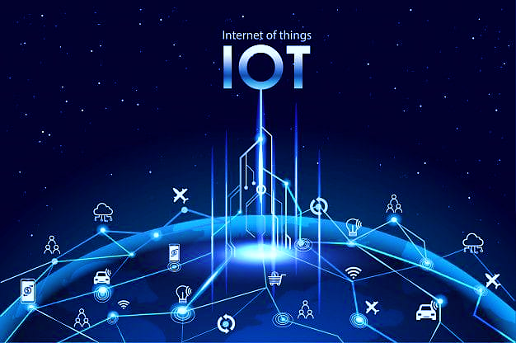
DEPI Sensors Co., LTD is a pioneering technology company & a leading provider of Internet of Things (IoT) sensors, dedicated to delivering innovative solutions that empower businesses across various industries. Our extensive portfolio includes a wide range of sensors designed for smart homes, industrial automation, environmental monitoring, and healthcare applications.
Sense the Future

Slide 7

Our Mission
02
Sense the Future

Slide 8
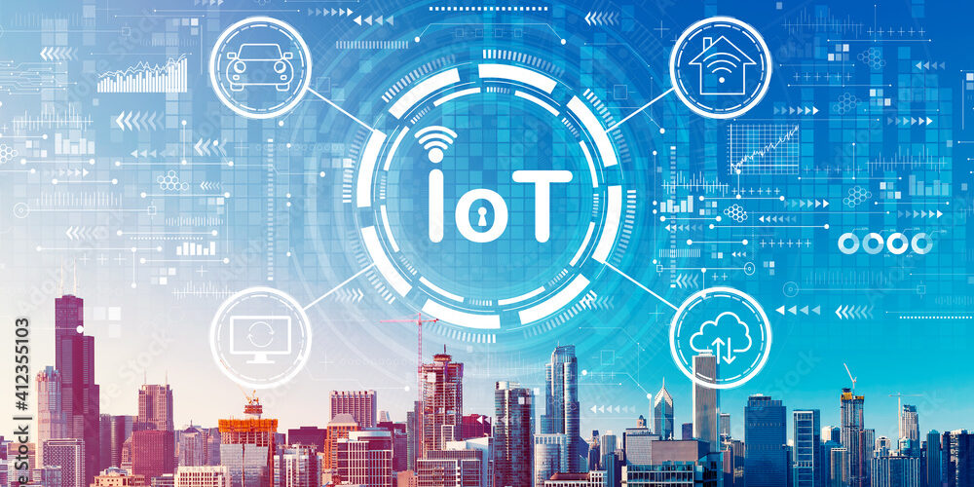
To empower businesses and communities with innovative IoT sensor technologies that drive smarter decision-making and promote a sustainable future, along with enabling our clients to optimize their operations.
Sense the Future

Slide 9
Our Vision
03
Sense the Future

Slide 10
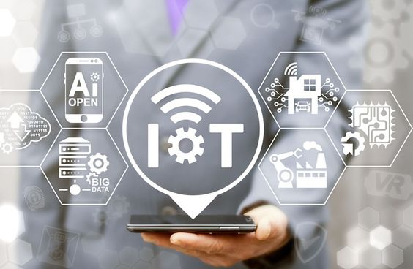
To be the preferred partner in IoT sensor distribution globally, driving the future of smart technology and contributing to a more connected world & transforming everyday environments into smart ecosystems through connected technology.
Sense the Future

Slide 11
Core Values
04
Sense the Future

Slide 12


Innovation:
Continuously seeking new technologies and solutions to meet the evolving needs of our customers.
Quality:
Committed to providing high-quality products that meet rigorous industry standards.
Customer-Centricity:
Prioritizing our customers’ needs and ensuring exceptional service and support.
Sustainability:
Promoting environmentally friendly practices in our operations and product offerings.
Sense the Future

Slide 13
Our Products
05
Sense the Future

Slide 14

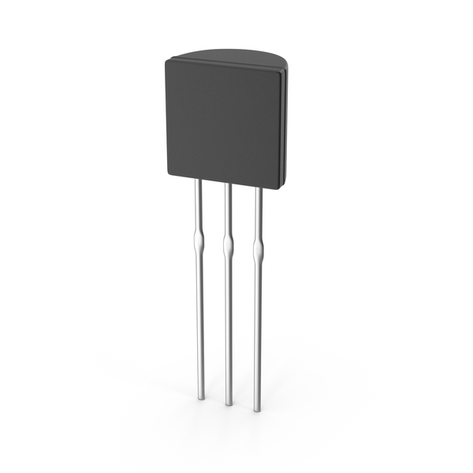
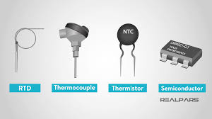
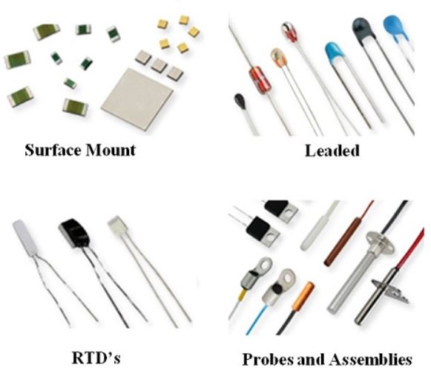

Temperature Sensors
(RTD 001)
Description: Sensors that measure temperature. They can be contact (thermocouples, thermistors) or non-contact (infrared sensors).
Applications: HVAC systems, weather stations, industrial processes, and home appliances.
Sense the Future

Slide 15
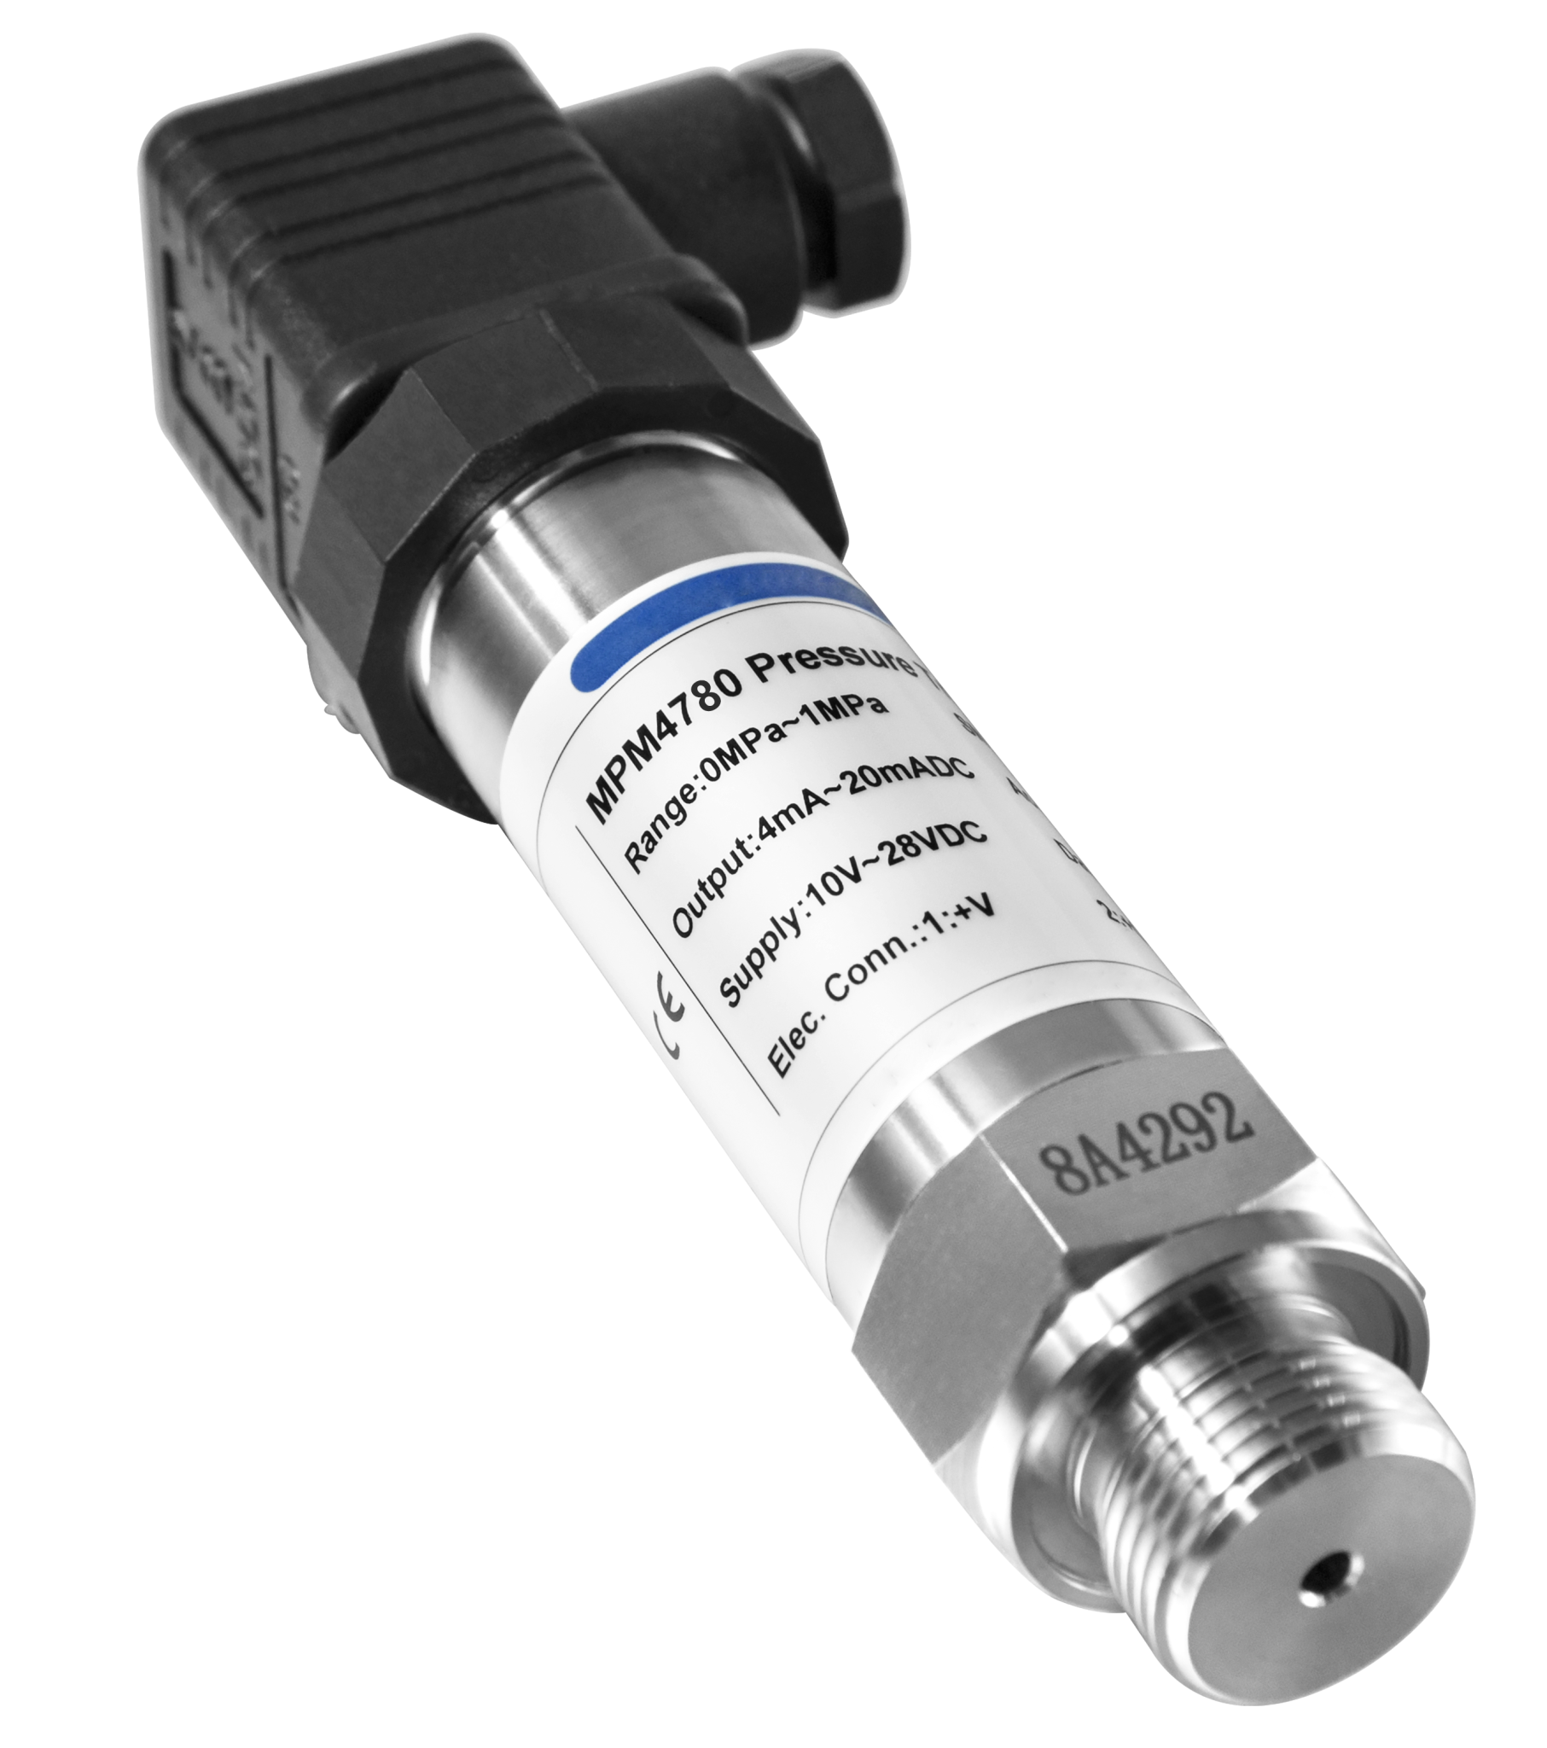
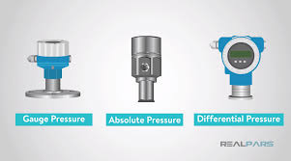
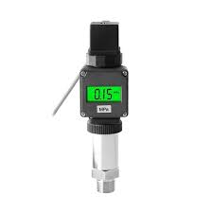
Pressure Sensors
(CAPS 002)
Description: Sensors that measure the pressure of gases or liquids. They can be absolute, gauge, or differential pressure sensors.
Applications: Automotive systems, weather monitoring, industrial equipment, and medical devices.
Sense the Future

Slide 16
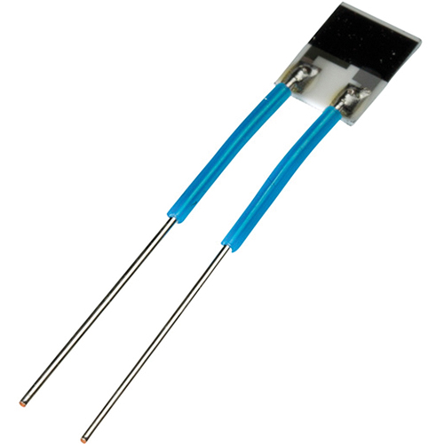
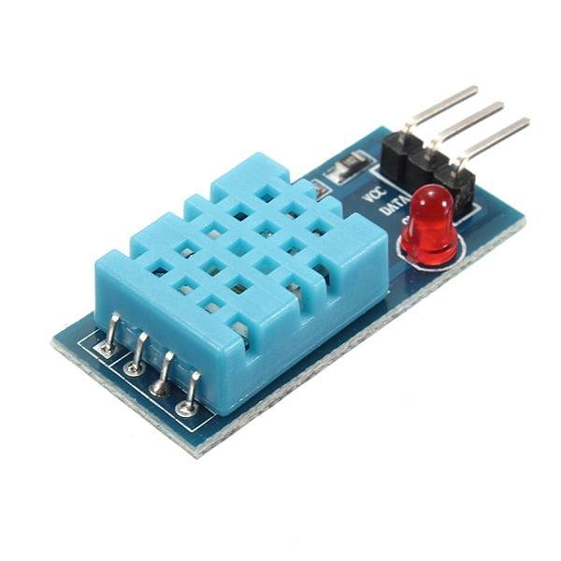
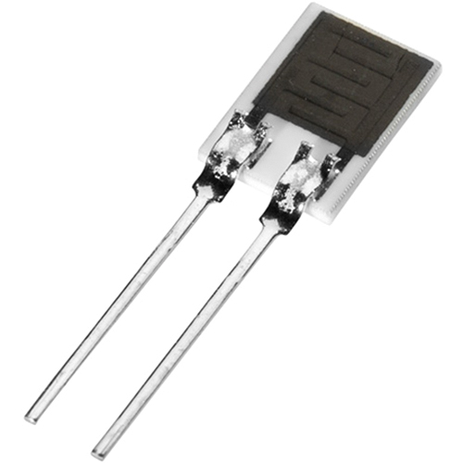
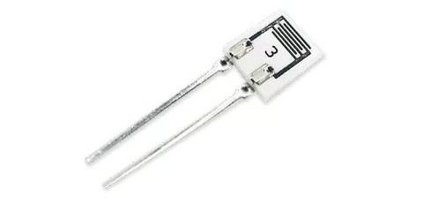
Humidity Sensors
(THS 003)
Description: Sensors that measure the amount of water vapor in the air. Common types include capacitive and resistive sensors.
Applications: HVAC systems, weather stations, greenhouses, and food storage.
Sense the Future

Slide 17
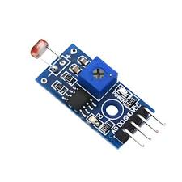
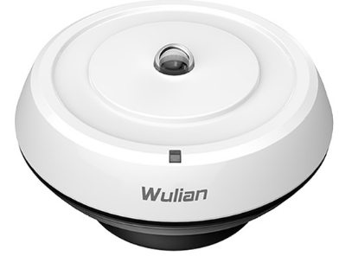
Light Sensors
(LDR 004)
Description: Sensors that detect light levels. Common types include photodiodes and photoresistors.
Applications: Automatic lighting systems, cameras, smartphones, and solar panels.
Sense the Future

Slide 18
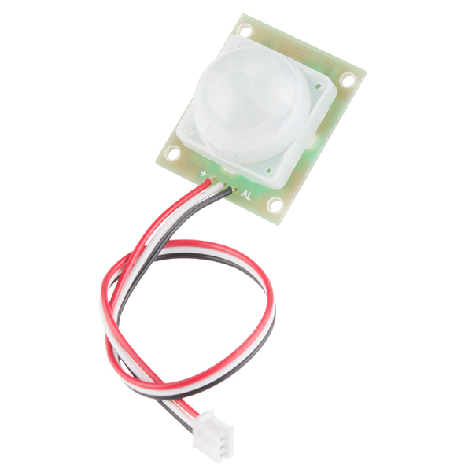
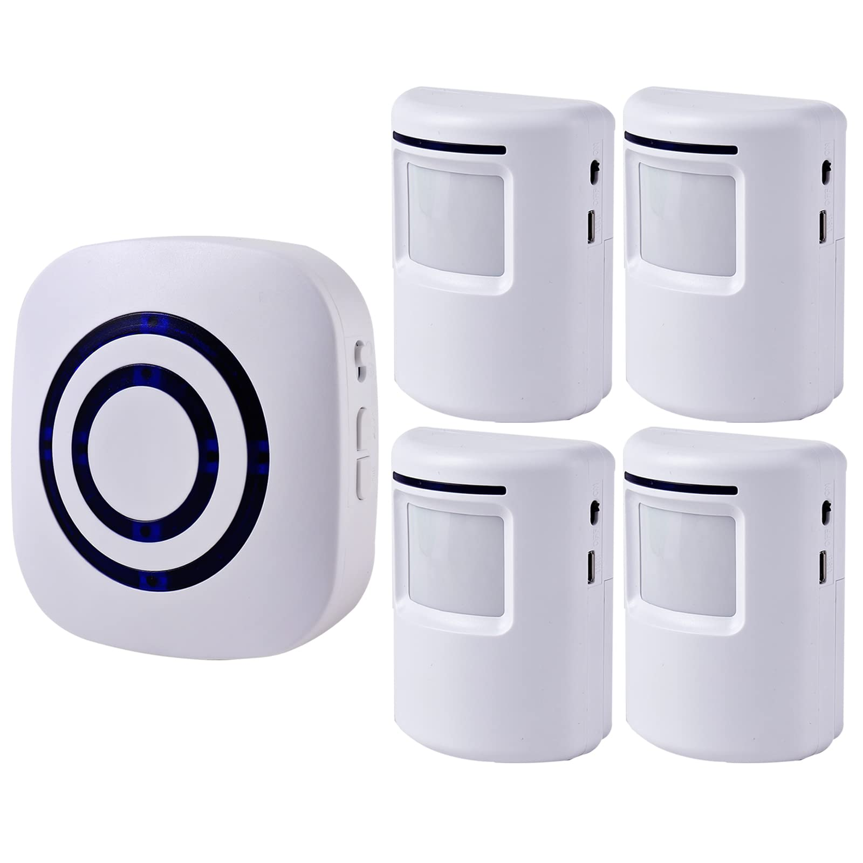
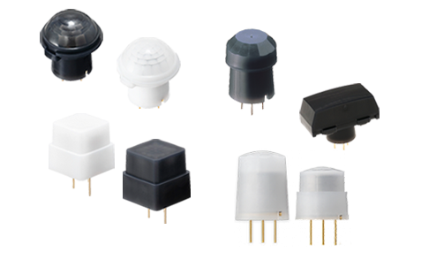
Motion Sensors
(PIR 005)
Description: Sensors that detect movement. Types include passive infrared (PIR), ultrasonic, and microwave sensors.
Applications: Security systems, automatic lighting, and smart home devices.
Sense the Future

Slide 19
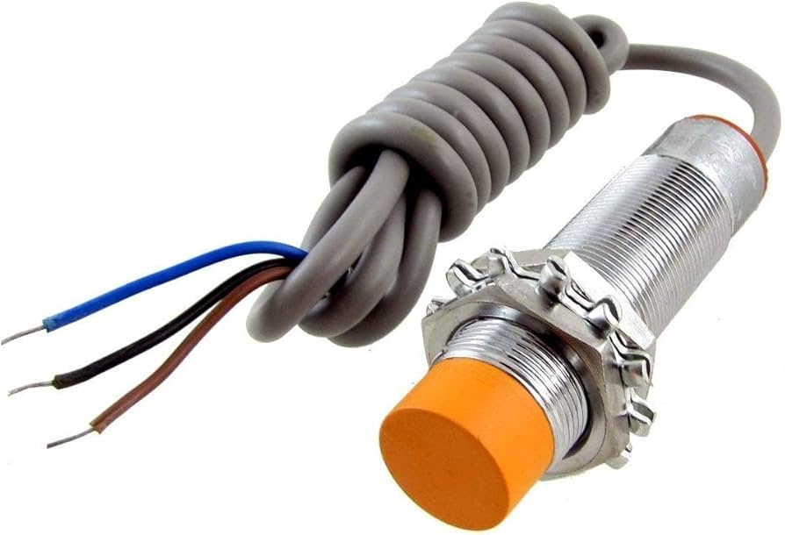
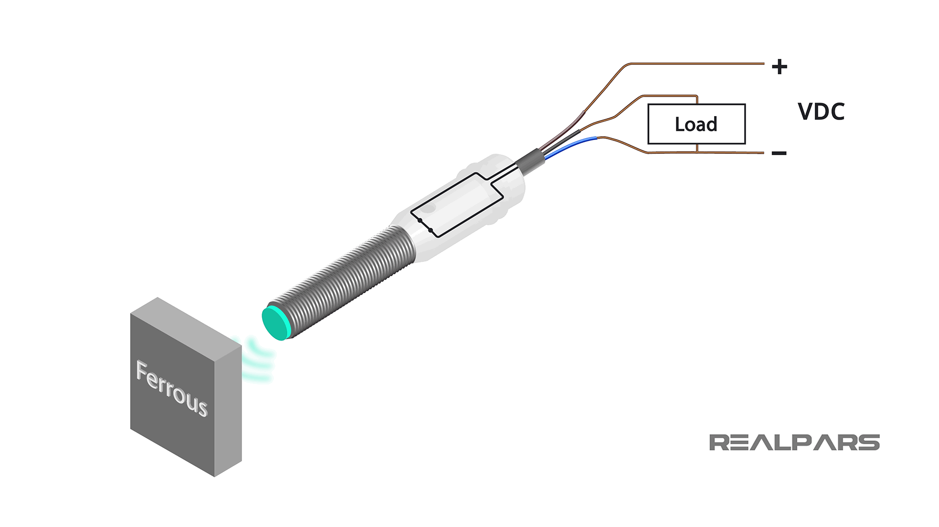
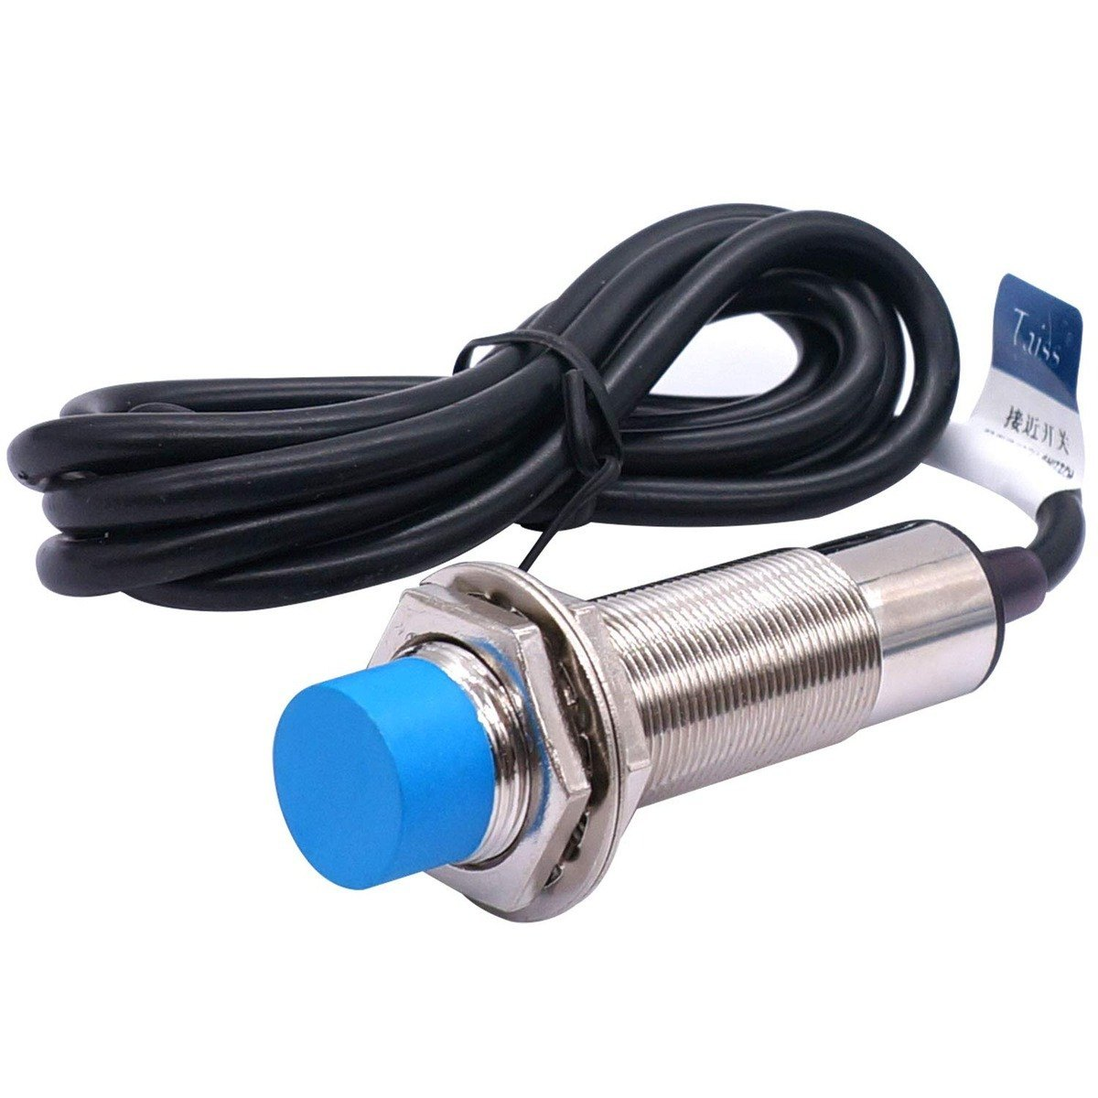
Proximity Sensors
(OPS 006)
Description: Sensors that detect the presence of an object without physical contact. Common types include capacitive, inductive, and ultrasonic sensors.
Applications: Industrial automation, smartphones, and automotive applications.
Sense the Future

Slide 20
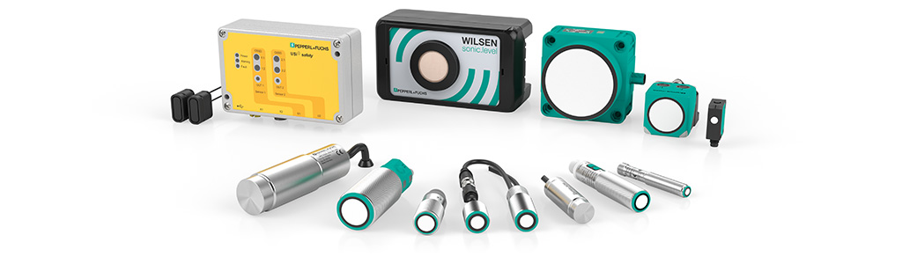
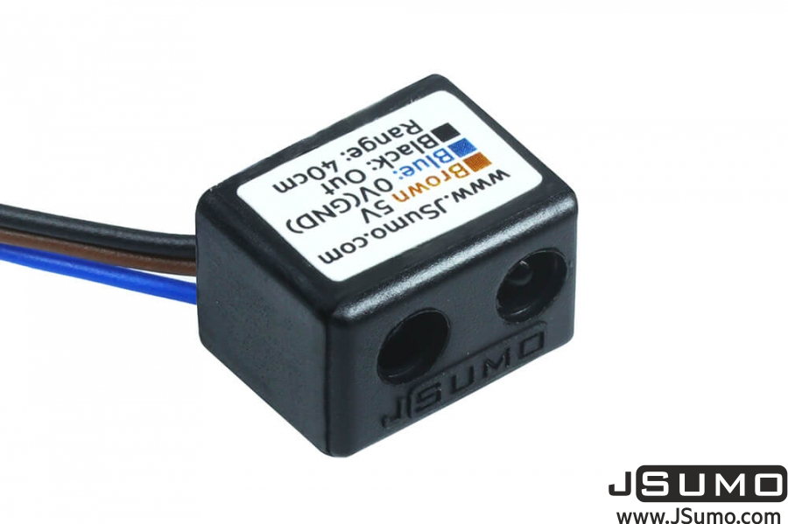
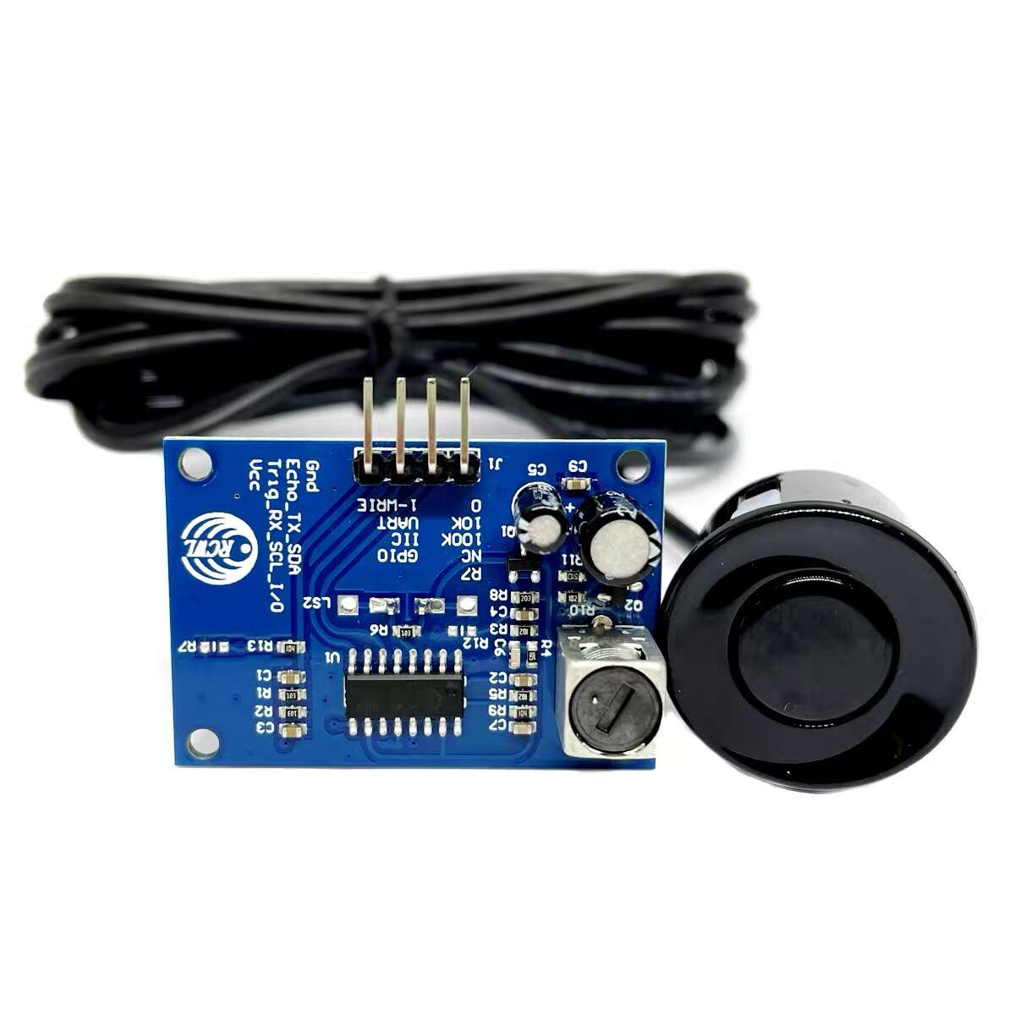
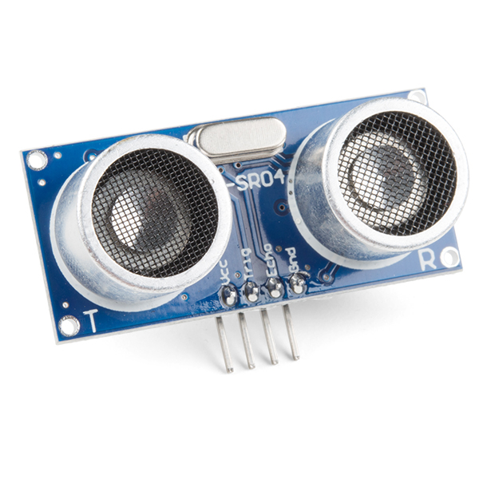
Distance Sensors
(UDS 007)
Description: Sensors that measure the distance to an object. Common types include ultrasonic, laser, and infrared sensors.
Applications: Robotics, automotive systems, and obstacle detection.
Sense the Future

Slide 21
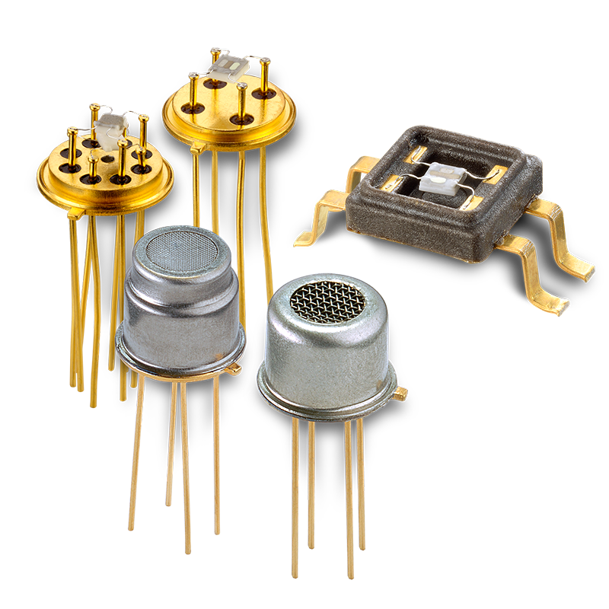
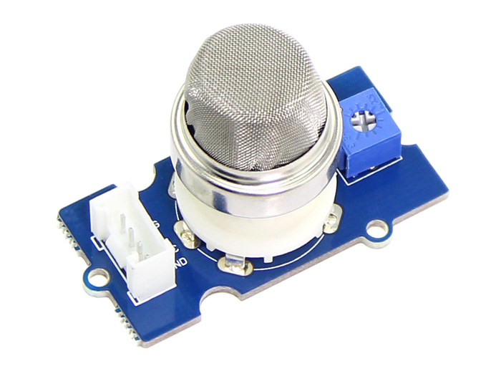
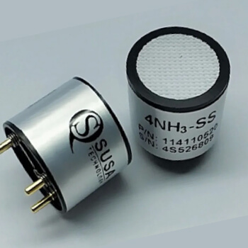
Gas Sensors
(MQ 008)
Description: Sensors that detect the presence of gases in an area. Common types include electrochemical, infrared, and metal oxide sensors.
Applications: Environmental monitoring, industrial safety, and home safety systems.
Sense the Future

Slide 22
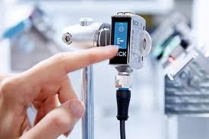
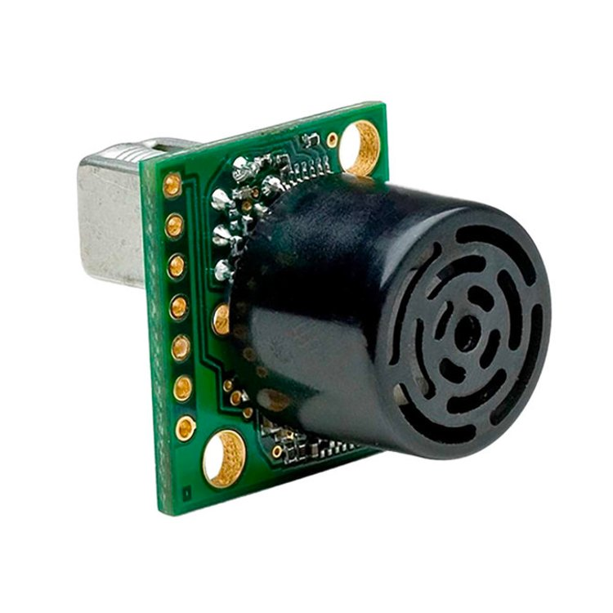
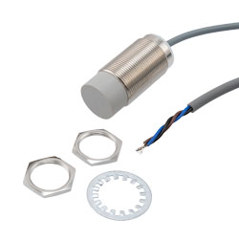
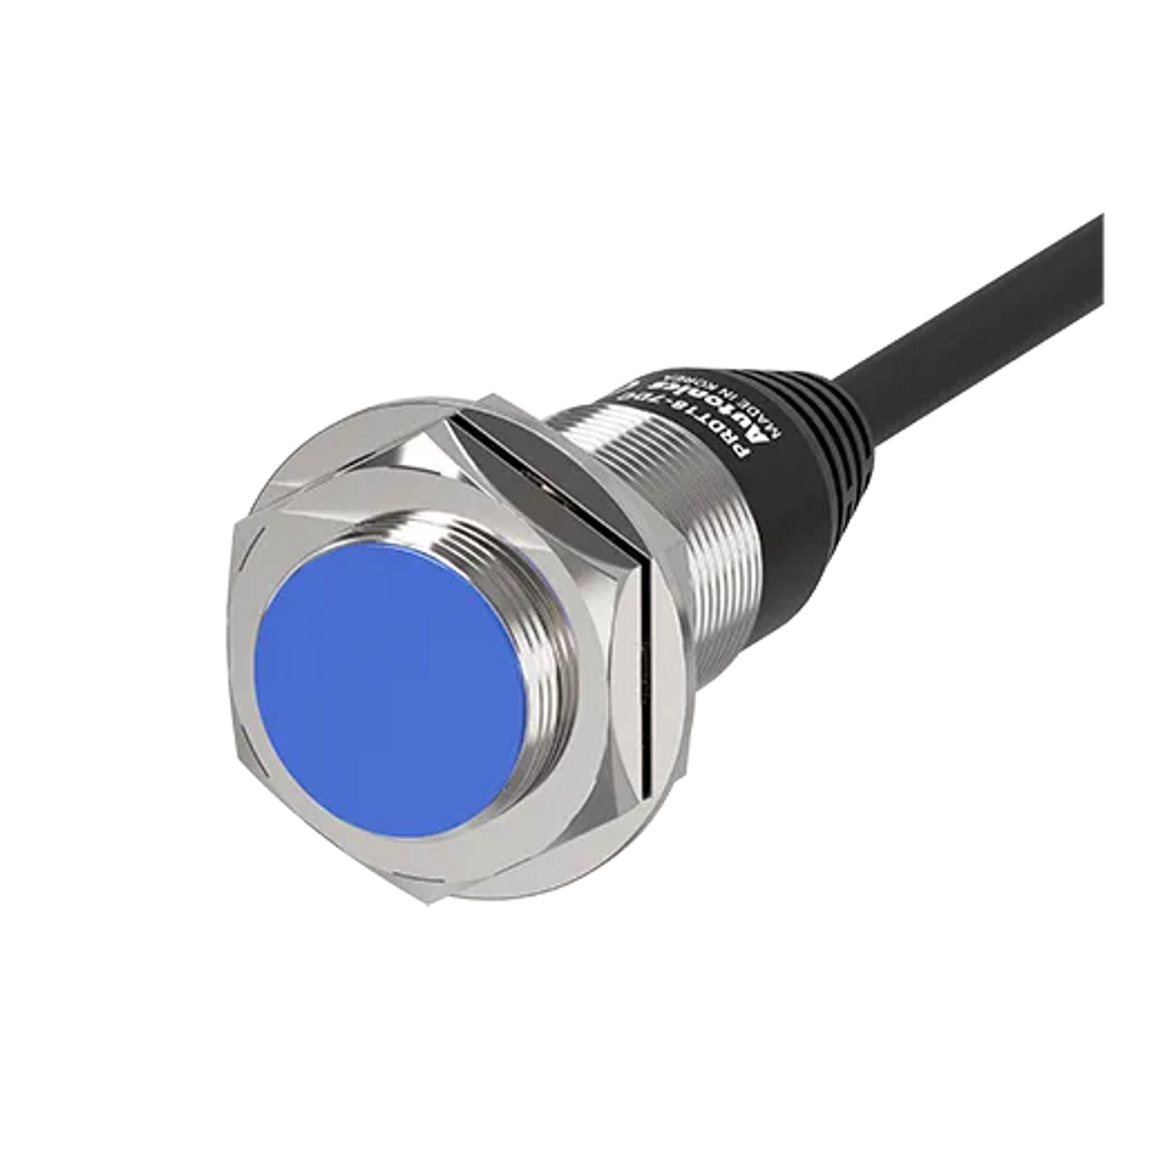
Proximity and Distance Sensors (LIDAR 009)
Description: Combined sensors that detect the presence of objects and measure their distance. They often use ultrasonic or laser technology.
Applications: Robotics, automation, and smart devices.
Sense the Future

Slide 23
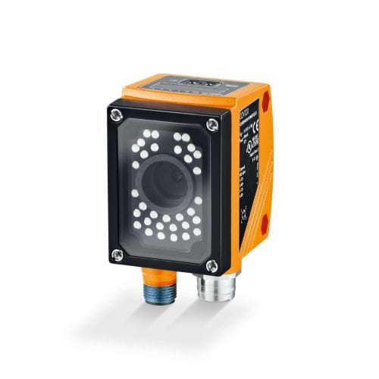
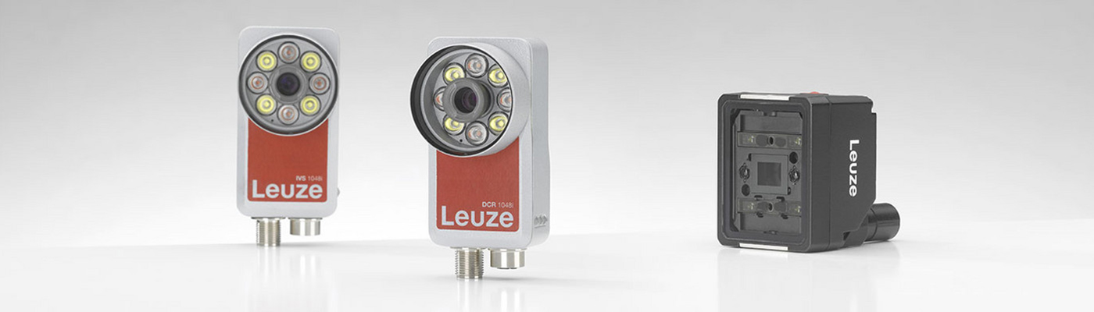
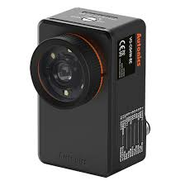
Vision Sensors
(RGBD 010)
Description: Cameras or imaging Sensors that analyze visual information. They can be used for object recognition, tracking, and inspection.
Applications: Industrial automation, autonomous vehicles, and security systems.
Sense the Future

Slide 24
Target Markets
06
Sense the Future

Slide 25

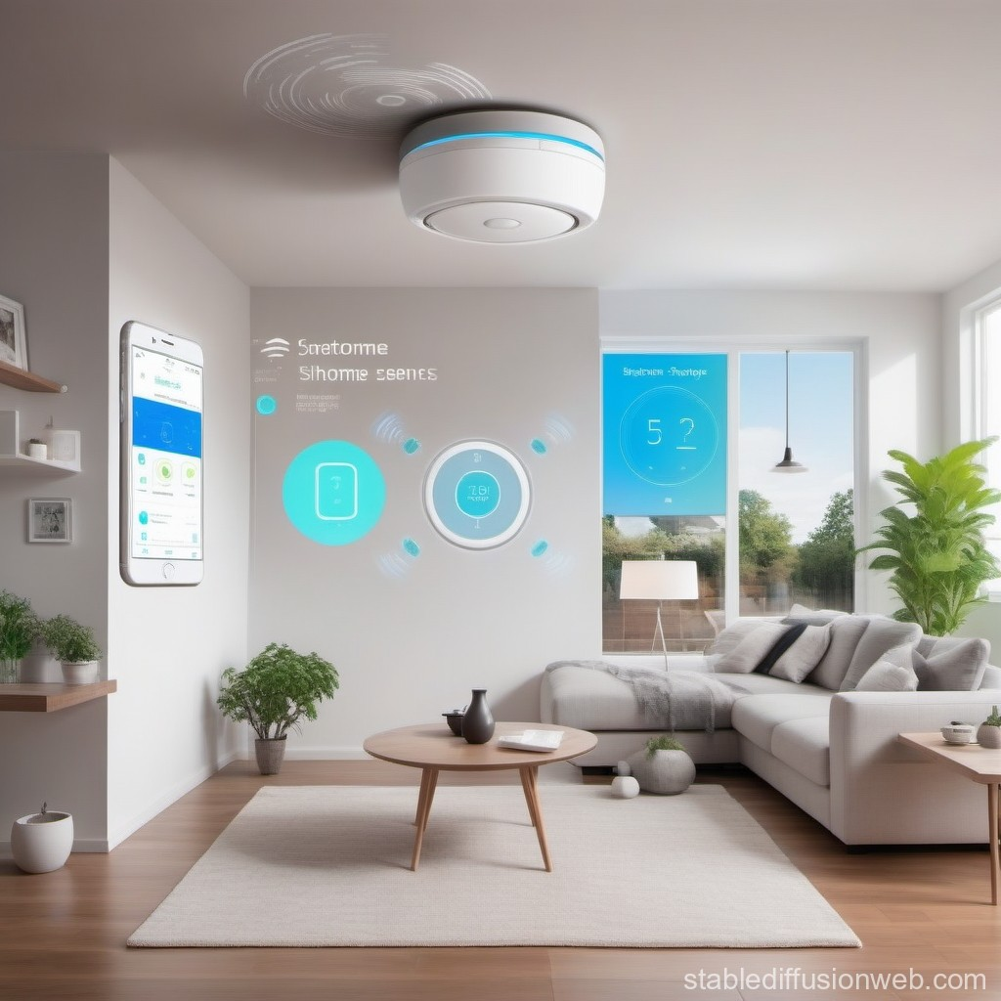
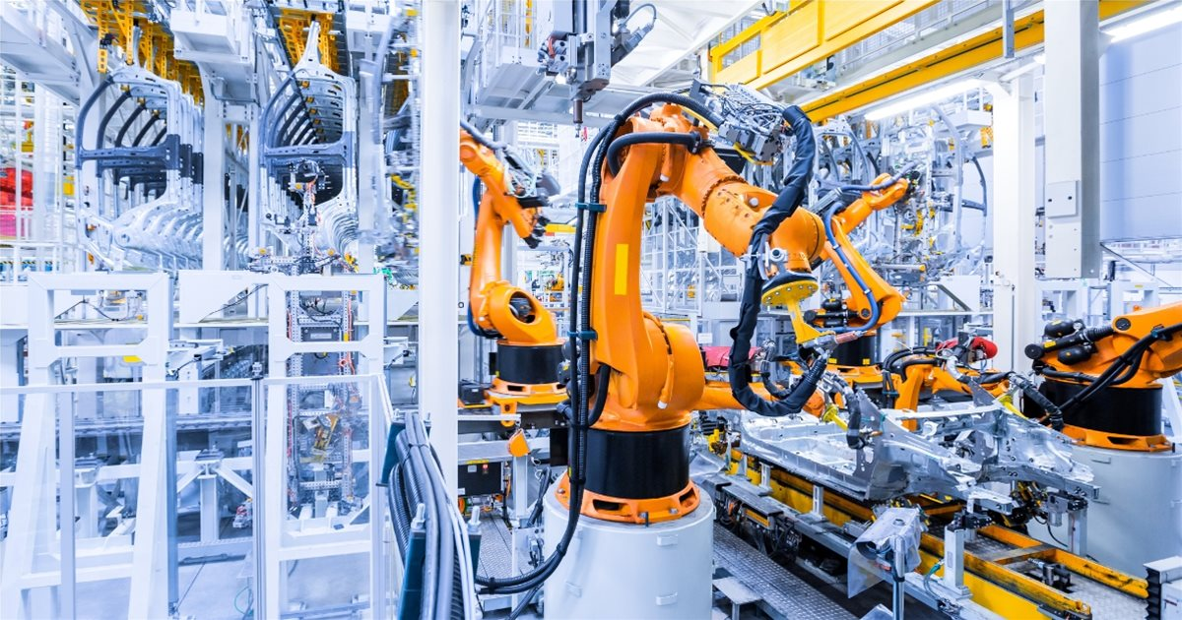
Smart Homes
Home automation
Security systems
Energy management
Smart appliances
Industrial Automation
Predictive maintenance
Asset tracking
Process optimization
Remote monitoring
Sense the Future

Slide 26
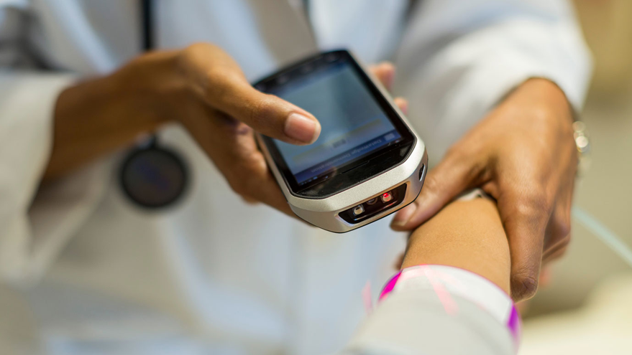
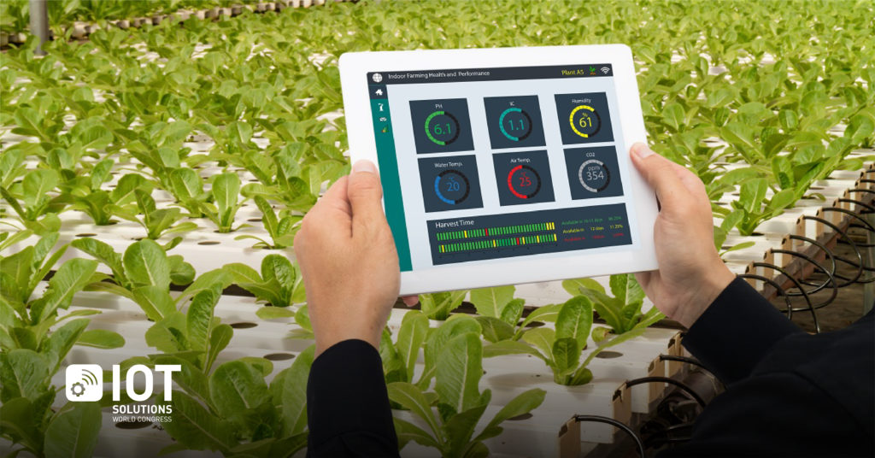
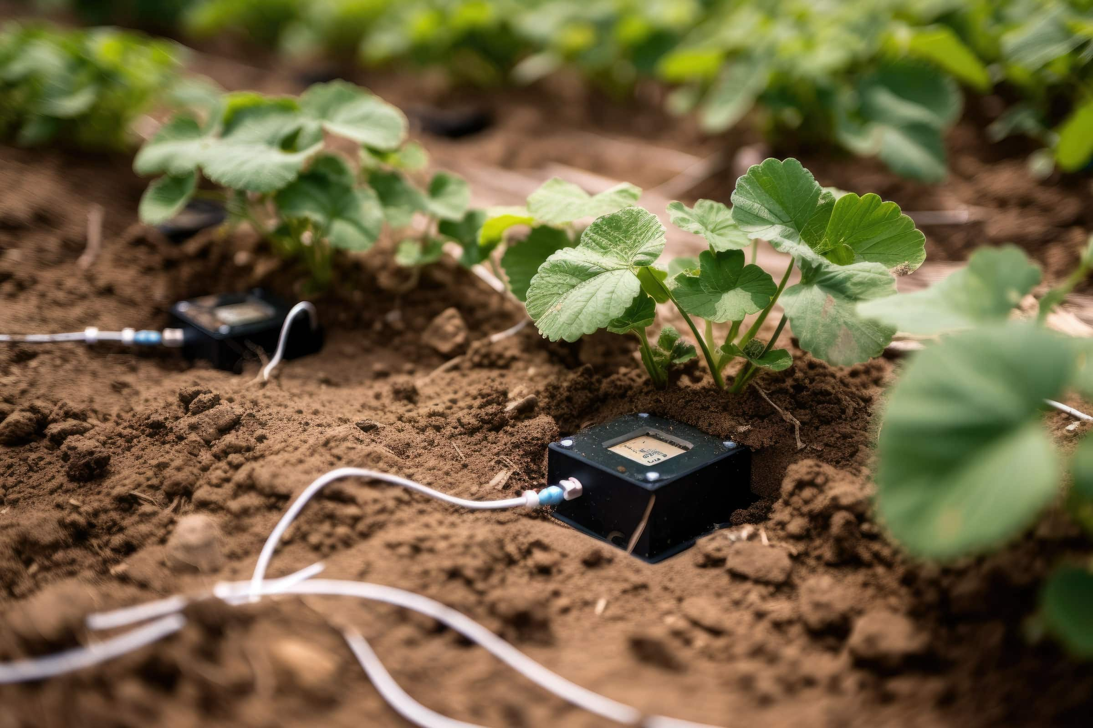
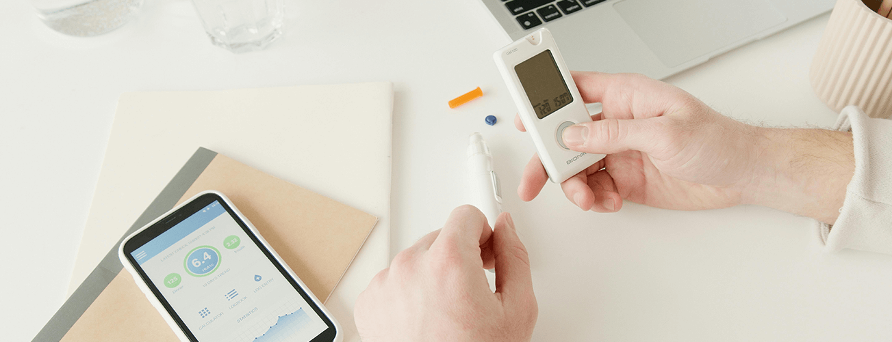
Healthcare
Remote patient monitoring
Wearable health devices
Smart medical equipment
Agriculture
Precision farming
Soil moisture monitoring
Climate control in greenhouses
Livestock tracking
Sense the Future

Slide 27
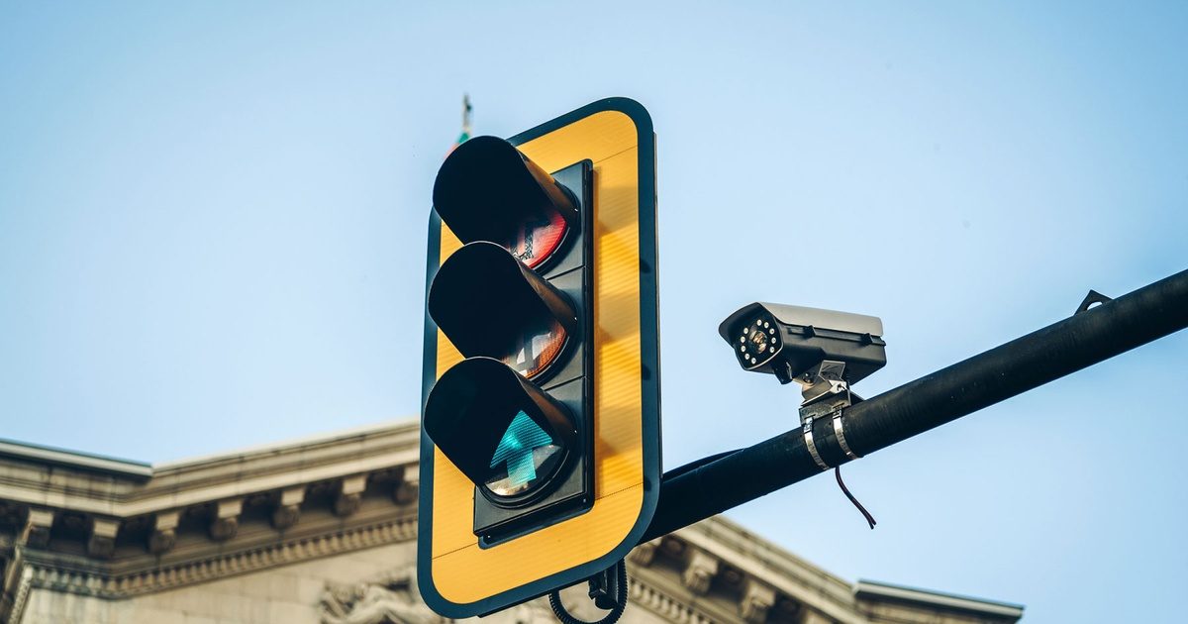
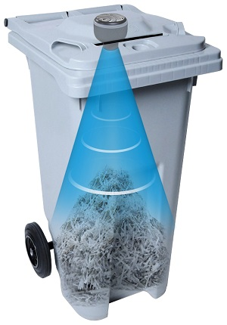
Smart Cities
Traffic management
Waste management
Environmental monitoring
Public safety
Transportation and Logistics
Fleet management
Asset tracking
Route optimization
Condition monitoring of goods
Sense the Future

Slide 28
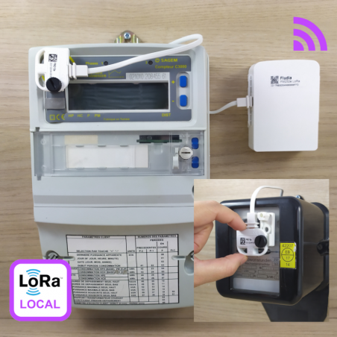
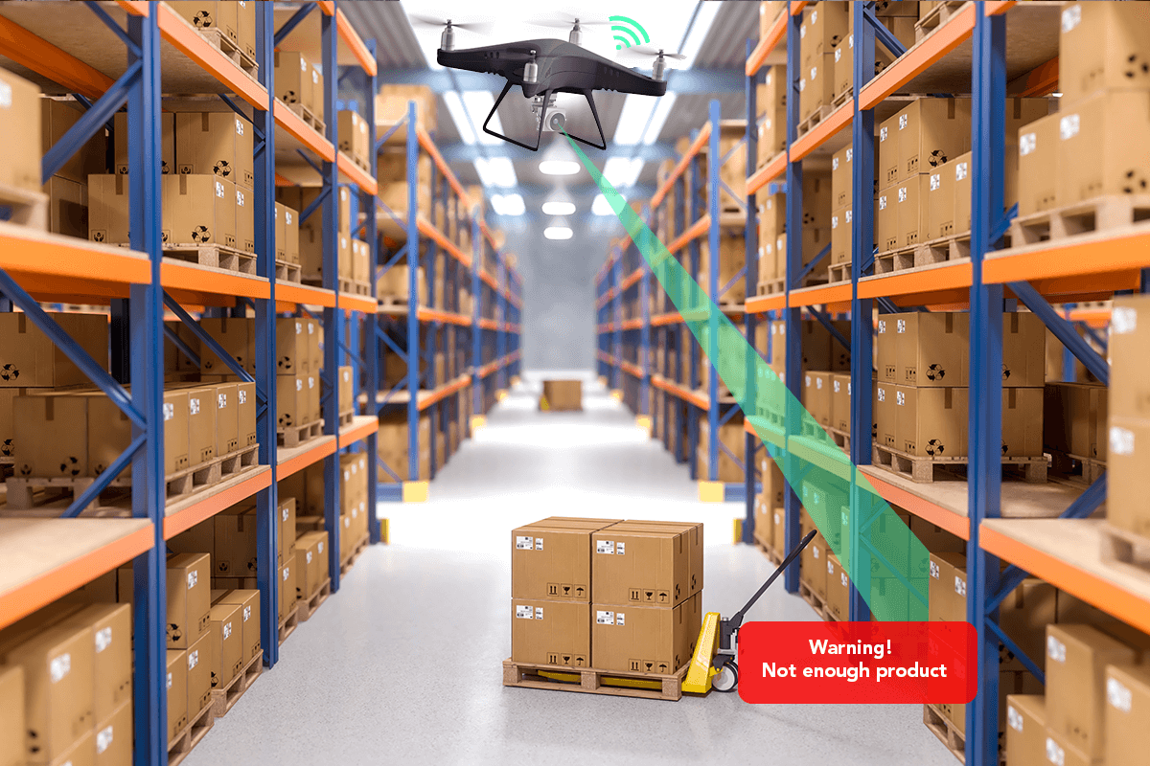
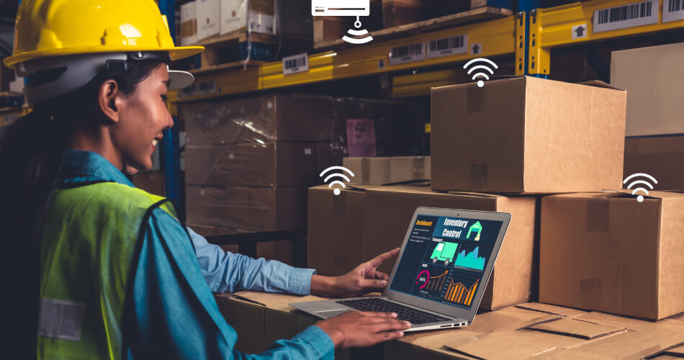
Energy Management
Smart grids
Energy consumption monitoring
Renewable energy integration
Demand response
Retail
Customer behavior analysis
Inventory management
Smart checkout solutions
Sense the Future

Slide 29
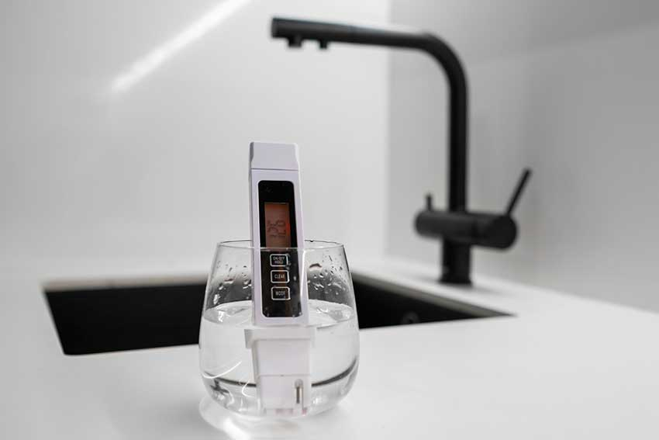
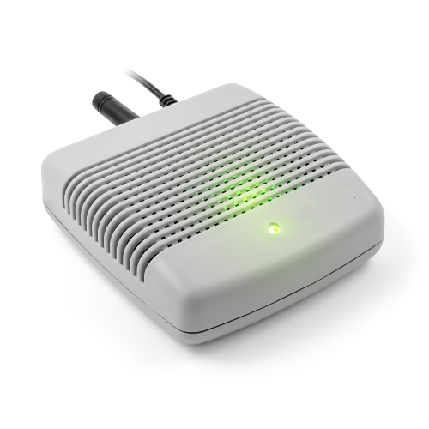
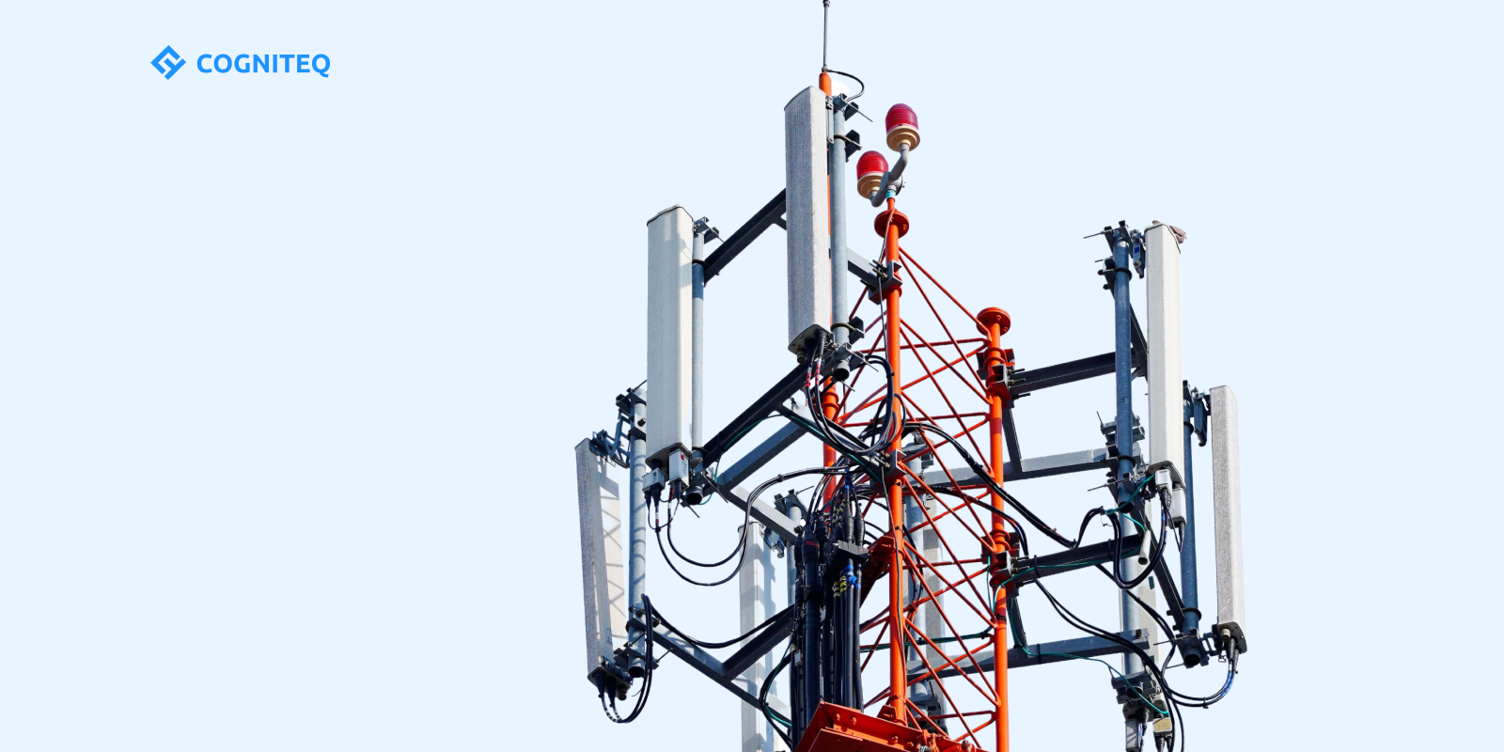
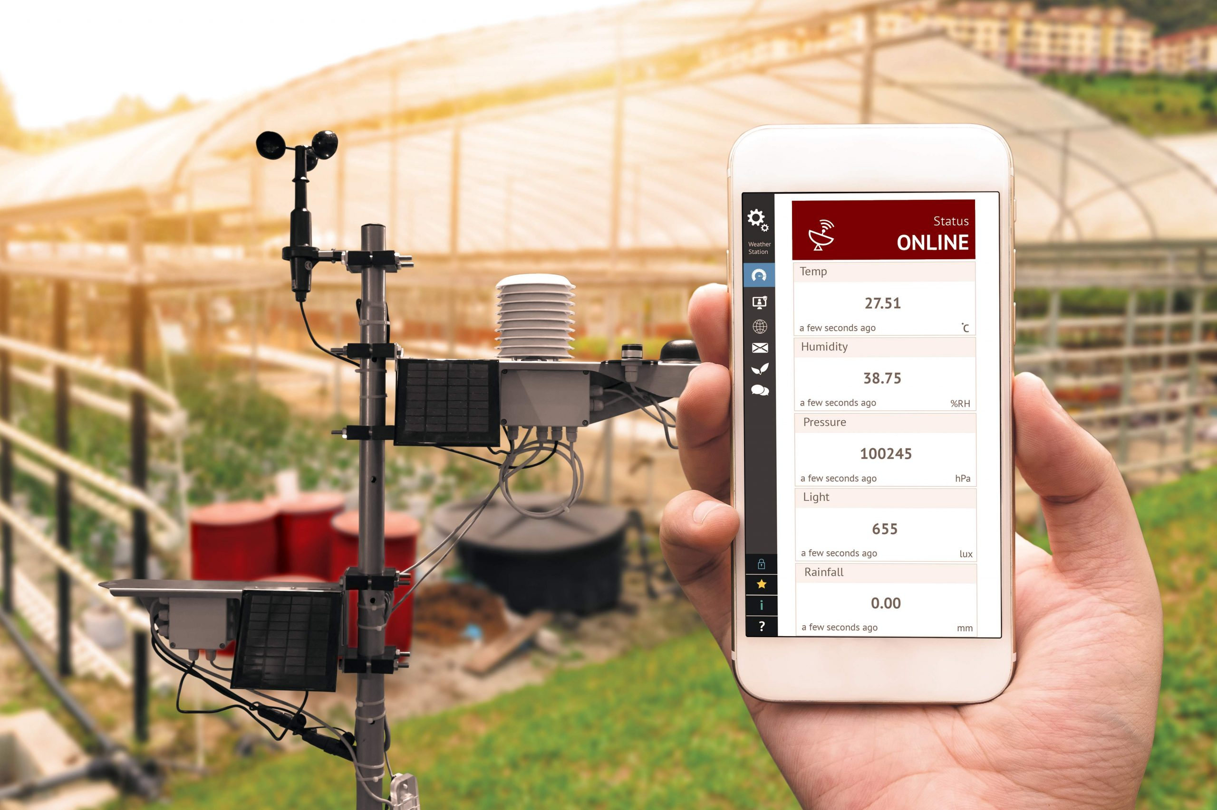
Environmental Monitoring
Air quality monitoring
Water quality testing
Climate change research
Telecommunications
Network optimization
Infrastructure monitoring
Predictive maintenance
Sense the Future

Slide 30



Automotive
Connected vehicles
Fleet management
Driver behavior monitoring
Building Management
HVAC control
Occupancy monitoring
Energy efficiency solutions
Sense the Future

Slide 31
Achievements
07
Sense the Future

Slide 32

Increased distribution channels by 30% in new markets.
Established strategic alliances with leading IoT sensor manufacturers.
Achieved a 50% year-over-year increase in sales volume.
Expanded into sectors like healthcare and agriculture.
Reduced packaging waste by 20% with eco-friendly practices.
Improved delivery times by 15%.
Grew online sales by 35% through enhanced marketing strategies.
Sense the Future

Slide 33


Contact Us
08
17, 5th Settlement, New Cairo, Egypt
123-456-7890
info@depisensors.com
www.depisensors.com
Sense the Future

Slide 34





Team Members
Asmaa Mohamed
Omaima Mohamed
Yousra Yusuf
Mostafa Fahmey
Esraa Ahmed
Sense the Future

Slide 35




We’re here to put a dent in the universe. Otherwise why else even be here”
— Steve Jobs
Sense the Future

Slide 36

Thank You
Sense the Future

